Slide 1
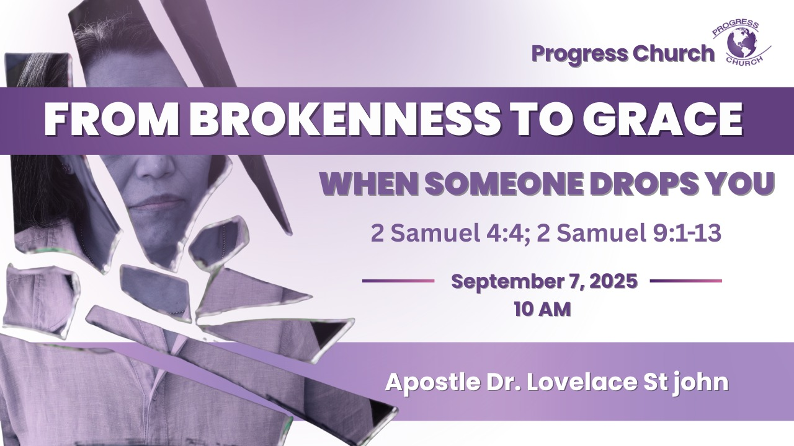

Slide 2



SCRIPTURE
2 Samuel 4:4; 2 Samuel 9:1–13

Slide 3
INTRODUCTION
To be “dropped” means to be disappointed, abandoned, betrayed, or wounded by others in ways that change the course of our lives.
Mephibosheth, the son of Jonathan and grandson of King Saul, is a vivid example of what it means to be dropped in life.
He was not only dropped physically by his nurse, but his entire destiny seemed to fall apart.
Yet, God still had a plan for him.

Slide 4
The Mephibosheth’s Drop, His Life’s Unexpected Pain. (2 Samuel 4:4)
Mephibosheth was only five years old, innocent, vulnerable, and dependent. Yet his life was forever changed by someone else’s mistake.
Some drops are necessary.
A Crown That He Would Not Wear.
The crown will never be placed upon his head!
The kingdom was to be ruled by another, the palace will now be occupied by another, and the crown will be worn by another.

Slide 5
2. Mephibosheth’s Condition Living in Lo-Debar. (2 Samuel 9:1-13)
Lo-Debar means “no pasture” or “no word” a barren, forgotten place.
The once royal grandson of a king was now living in obscurity, broken, and afraid.
He went to a place where there is nowhere to grow grass, nowhere to plant flowers, and no place for a harvest, but at least he is safe, and he is provided for.

Slide 6

3. Mephibosheth’s Restoration, The King’s Table.
King David remembered his covenant with Jonathan and asked, “Is there still anyone left of the house of Saul, that I may show him kindness for Jonathan’s sake?” (2 Samuel 9:1).
The exile is now over and the king says, "thou shalt eat bread at my table continually."
Though others dropped Mephibosheth, the king lifted him. Though he was lame, he was accepted. Though he was forgotten, he was restored.

Slide 7
4. Christ The Greater David.
David is a picture of Christ, the Son of David, who seeks us out when we are broken and living in spiritual Lo-Debar.
Just as Mephibosheth was carried to the king’s table, so we are carried by grace into God’s presence.
Like Mephiboseth, we have received an invitation. The King of kings is inviting you to come to the throne.

Slide 8
CONCLUSION:
Release those who dropped you. Forgive them, because God is greater than their mistake.
Refuse to stay in Lo-Debar. Don’t let pain define you, let God’s promise redefine you.
Receive God’s restoration. What was lost can be restored when you remain at the King’s table.
When others drop you, God’s grace will pick you up. He will lift you from Lo-Debar to the King’s table, where your brokenness is covered and your inheritance is restored.

